Slide 1


JAVA EE
(AdvAnce JAVA)
Lecture-2

Slide 2
Today’s Agenda
Introduction to JDBC.
History and editions of JDBC.
JDBC architecture.
How JDBC manages connections to the database ?

Slide 3
QUIZ
Q1. What does Java EE stand for ?
A. Java Expert Edition
B. Java Enterprise Edition
C. Java Extra Edition
D. None Of These
Answer: B

Slide 4
QUIZ
Q2. What kind of applications can be built using JEE?
A. Web Applications
B. Enterprise Applications
C. Both A & B
D. Console Applications
Answer: C

Slide 5
QUIZ
Q3. What is a web server ?
A. A software that delivers static pages
B. A software that delivers dynamic pages
C. Both A & B
D. None of these
Answer: A

Slide 6
QUIZ
Q4. What is an Application Server ?
A. A software that delivers static pages
B. A software that delivers dynamic pages
C. Both A & B
D. None of these
Answer: B

Slide 7
QUIZ
Q5. What is a Web Container?
A. A full JEE compliant server
B. A software that serves HTTP request
C. Both A & B
D. A partial JEE compliant server
Answer: D

Slide 8
QUIZ
Q6. Which of the following are web-server?
A. Microsoft IIS
B. Apache TOMEE
C. Apache TOMCAT
D. RedHat JBOSS
Answer: A

Slide 9
QUIZ
Q7. Which of the following are Application-server?
A. Microsoft IIS
B. Apache TOMEE
C. Apache TOMCAT
D. Apache HTTPD
Answer: B

Slide 10
QUIZ
Q8. What is JAVA EE?
A. A programming language
B. A set of java tools
C. A compiler
D. A specification
Answer: D

Slide 11
QUIZ
Q9. What is GLASSFISH?
A. SUN’s Web Server
B. SUN’s Web Container
C. SUN’s JEE compliant Application Server
D. None Of These
Answer: C

Slide 12
QUIZ
Q10. What is an HTTP Request ?
A. Request sent by the browser for getting static page
B. Request sent by the browser for getting dynamic page
C. Both A & B
D. None Of These
Answer: C

Slide 13
Introduction of JDBC
Unofficial full-form of JDBC is Java Database Connectivity.
It is an API used for connecting programs written in java with the relational database.
Programs developed with Java/JDBC are platform and vendor independent.

Slide 14
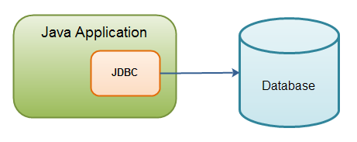
Introduction of JDBC

Slide 15
History and Edition
JDBC is maintained by JavaSoft, a sister concern of
Oracle-SUN
It was released as a part of JDK 1.1 on February 19,1997 and was called JDBC 1.0.
Later in 2006 , with Java 6, JDBC 4.0 was released
Java SE 8 includes the latest version of JDBC called JDBC 4.2

Slide 16
How JDBC maintains connection to the database ?
JDBC communicates with the database using a special set of classes called Driver classes .
These driver classes perform the real communication with the database in it’s native form.
Further to manage these driver classes JDBC provides another top level class called DriverManager

Slide 17
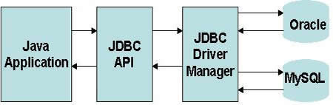
How JDBC maintains connection to the database ?

Slide 18
JDBC Driver Types
Today, there are four types of JDBC drivers in use:
Type 1: JDBC-ODBC bridge Driver.
Type 2: Partial Java Driver.
Type 3: Network API Driver
Type 4: Pure Java Driver

Slide 19
JDBC-ODBC Bridge Driver
The JDBC-ODBC bridge driver uses ODBC driver to
connect to the database.
ODBC stands for Open Database Connectivity and is a
Microsoft technology
The JDBC-ODBC bridge driver converts JDBC
method calls into the ODBC function calls.

Slide 20
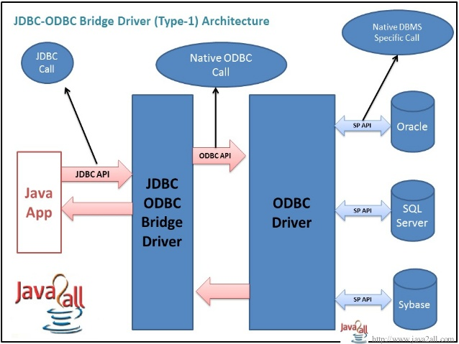
Architecture

Slide 21
JDBC-ODBC Bridge
Advantage:
Can be used to connect with variety of databases.
It’s an easy for installation as well as easy(simplest) to use as compare the all other driver.
Continued

Slide 22
JDBC-ODBC Bridge
Disadvantage:
This is the slowest driver.
Since it is a Microsoft technology so our java application can use it only when it runs on Windows platform.
It only supports basic SQL types like varchar2,number,date but doesn’t supports advanced types like BLOB,CLOB etc
Continued

Slide 23
Pure Java Driver
It is also called Native Protocol Driver
This is because it converts JDBC calls directly into the
vendor specific database protocol.
Moreover it is fully written in Java language.

Slide 24
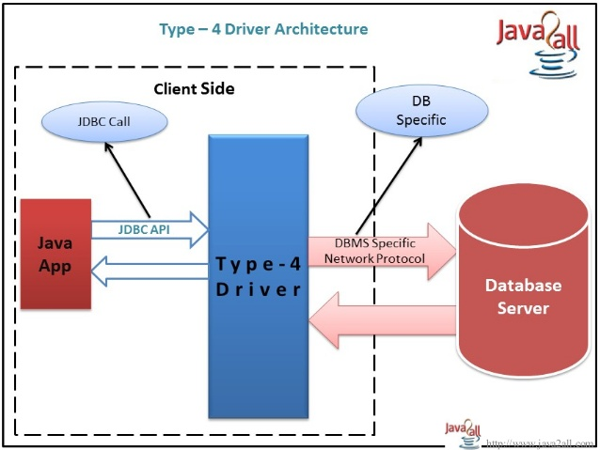
Architecture

Slide 25
ADVANTAGE AND DISADVANTAGE
ADVANTAGE:
Better performance
No middleware is needed while connecting to the database.
DISADVANTAGE:
Drivers are dependent on dataabse.
There is a separate driver for each database.

Slide 26

End Of Lecture 2
For any queries mail us @: scalive4u@gmail.com
Call us @ : 0755-4271659, 7879165533
Agenda for Next Lecture:
Jdbc Packages
Steps required in JDBC progammin

